Slide 1
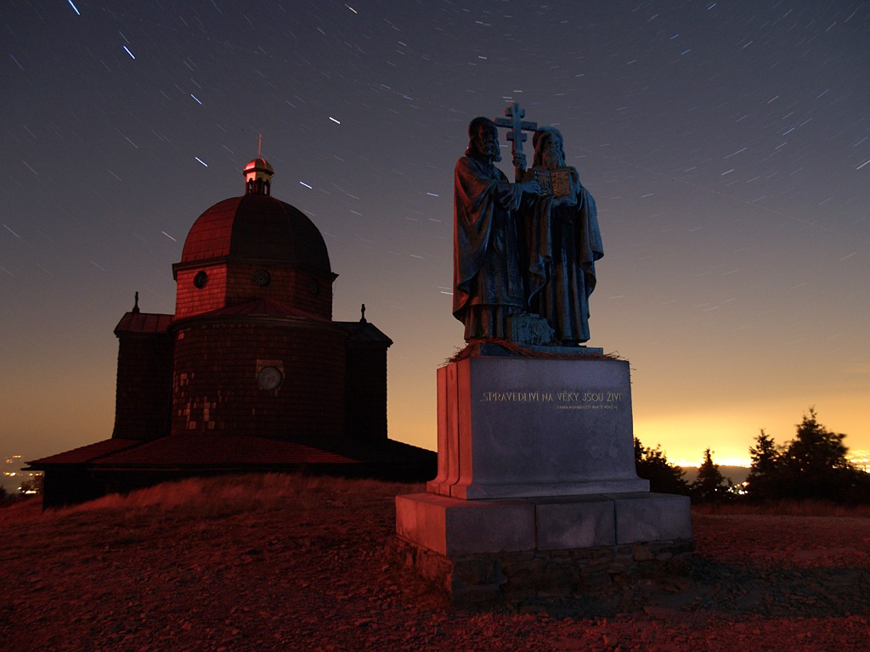
To the Lord’s windows…

Slide 2
Those pictures were captured in Czech republic. Arose under natural sky, some objects are illuminated only by hand-held torch …

Slide 3
Wooden Church of the virgin Mary at Gruň

Slide 6
Church of saint Henry at Staré Hamry

Slide 9
Church saint Mary Magdalene in the Kunčice pod Ondřejníkem

Slide 11
Chapel of saint Anthony of Padua in Solárka in Frýdlant upon Ostravice.

Slide 12
Wooden chapel with a statue in the Trojanovice at Bystré

Slide 14
Statue of Radegast at Pustevny

Slide 15
Chapel of saint Cyril a Methodius on Radhošť

Slide 17
If somebody wants to illuminate those magnificent monuments, those photos could ever occur…

Slide 18
Consider where you really want to shine…

Slide 19
On the monuments or on the sky?

Slide 20
On the clouds?

Slide 21
To the Lord’s windows???

Slide 22
Solution exists…
Off tacky lights from the ground! Shine from the top down!
Do not allow overlaps occur, illuminate only monuments, not the air above it!
Don’t shine to every bit of space, highlight the details!
The monument is no need to light up the whole night, when activity pass ...

Slide 23
The aim of the presentation wasn’t idea „let’s switch off lights, shining is wrong“. The aim of the presentation is give subject for thought and tell idea that shine to monuments, but with brain.

Slide 24
Motto at the end
„To celebrate what we created for God, we do not see what God created for man. "

