Slide 1
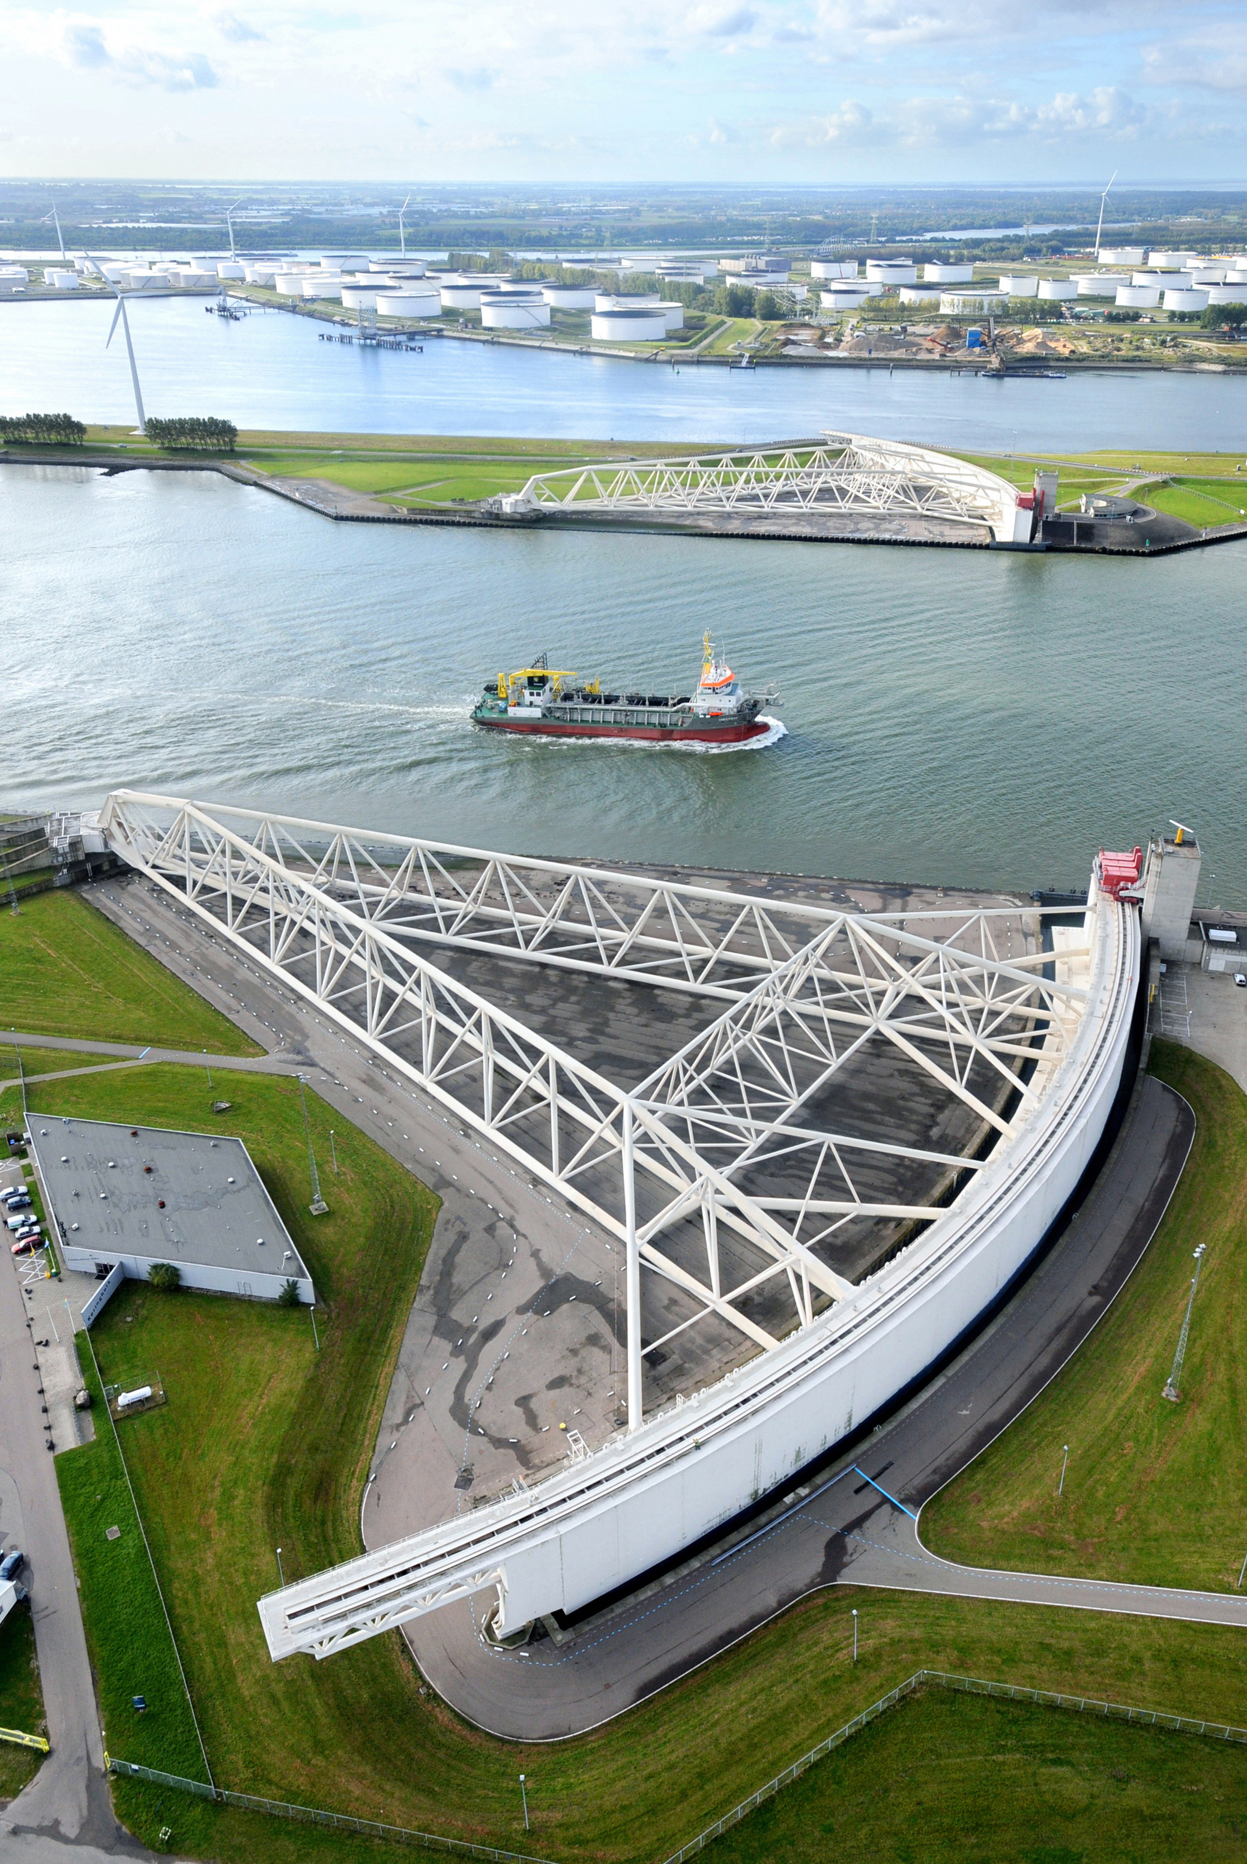
THE WORKING GROUP II
CONTRIBUTION TO THE IPCC'S
FIFTH ASSESSMENT REPORT

Slide 2
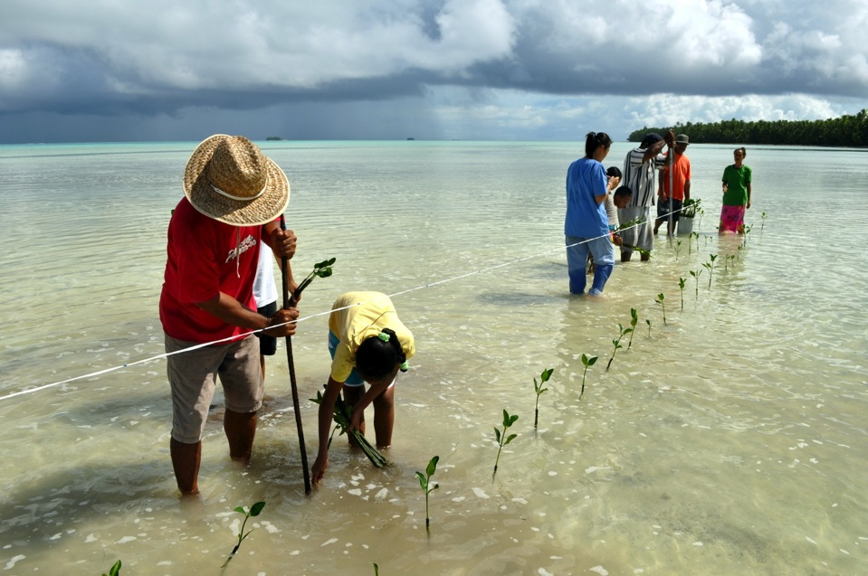
CLIMATE CHANGE 2014:
IMPACTS, ADAPTATION, AND VULNERABILITY

Slide 3



IMPACTS
CLIMATE
SOCIOECONOMIC
PROCESSES
Vulnerability
Natural
Variability
Socioeconomic
Pathways
Hazards
RISK
Adaptation and Mitigation Actions
Anthropogenic
Climate Change
Governance
Exposure
EMISSIONS
and Land-use Change

Slide 4
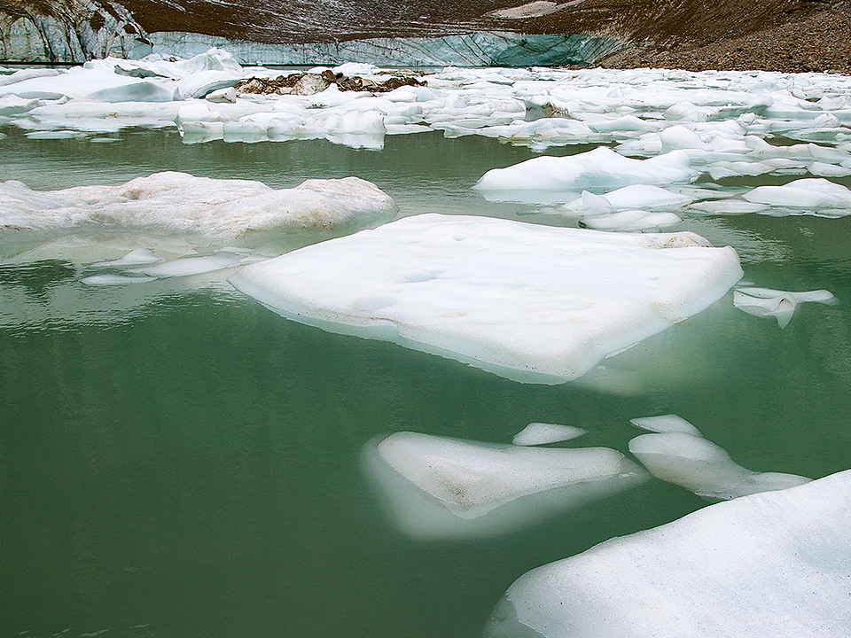
WIDESPREAD
OBSERVED IMPACTS
A CHANGING WORLD

Slide 5
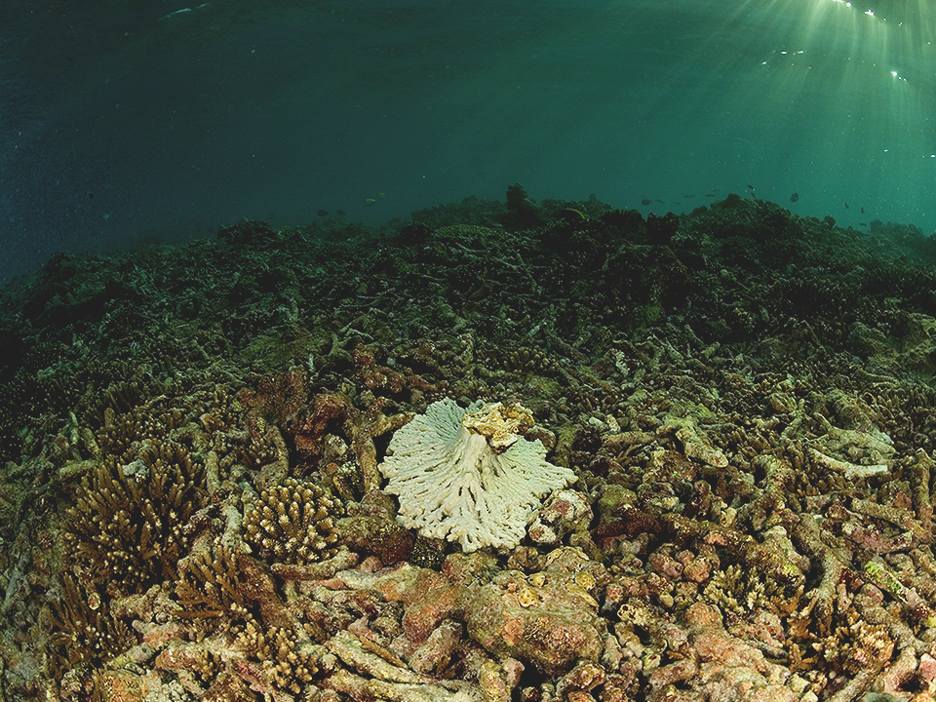
WIDESPREAD
OBSERVED IMPACTS
A CHANGING WORLD

Slide 6
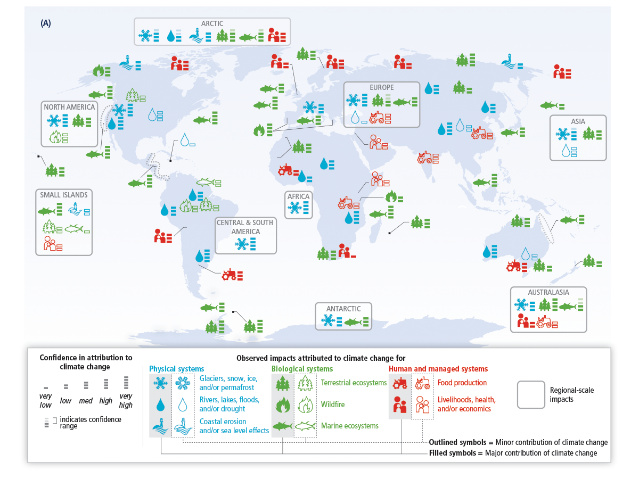
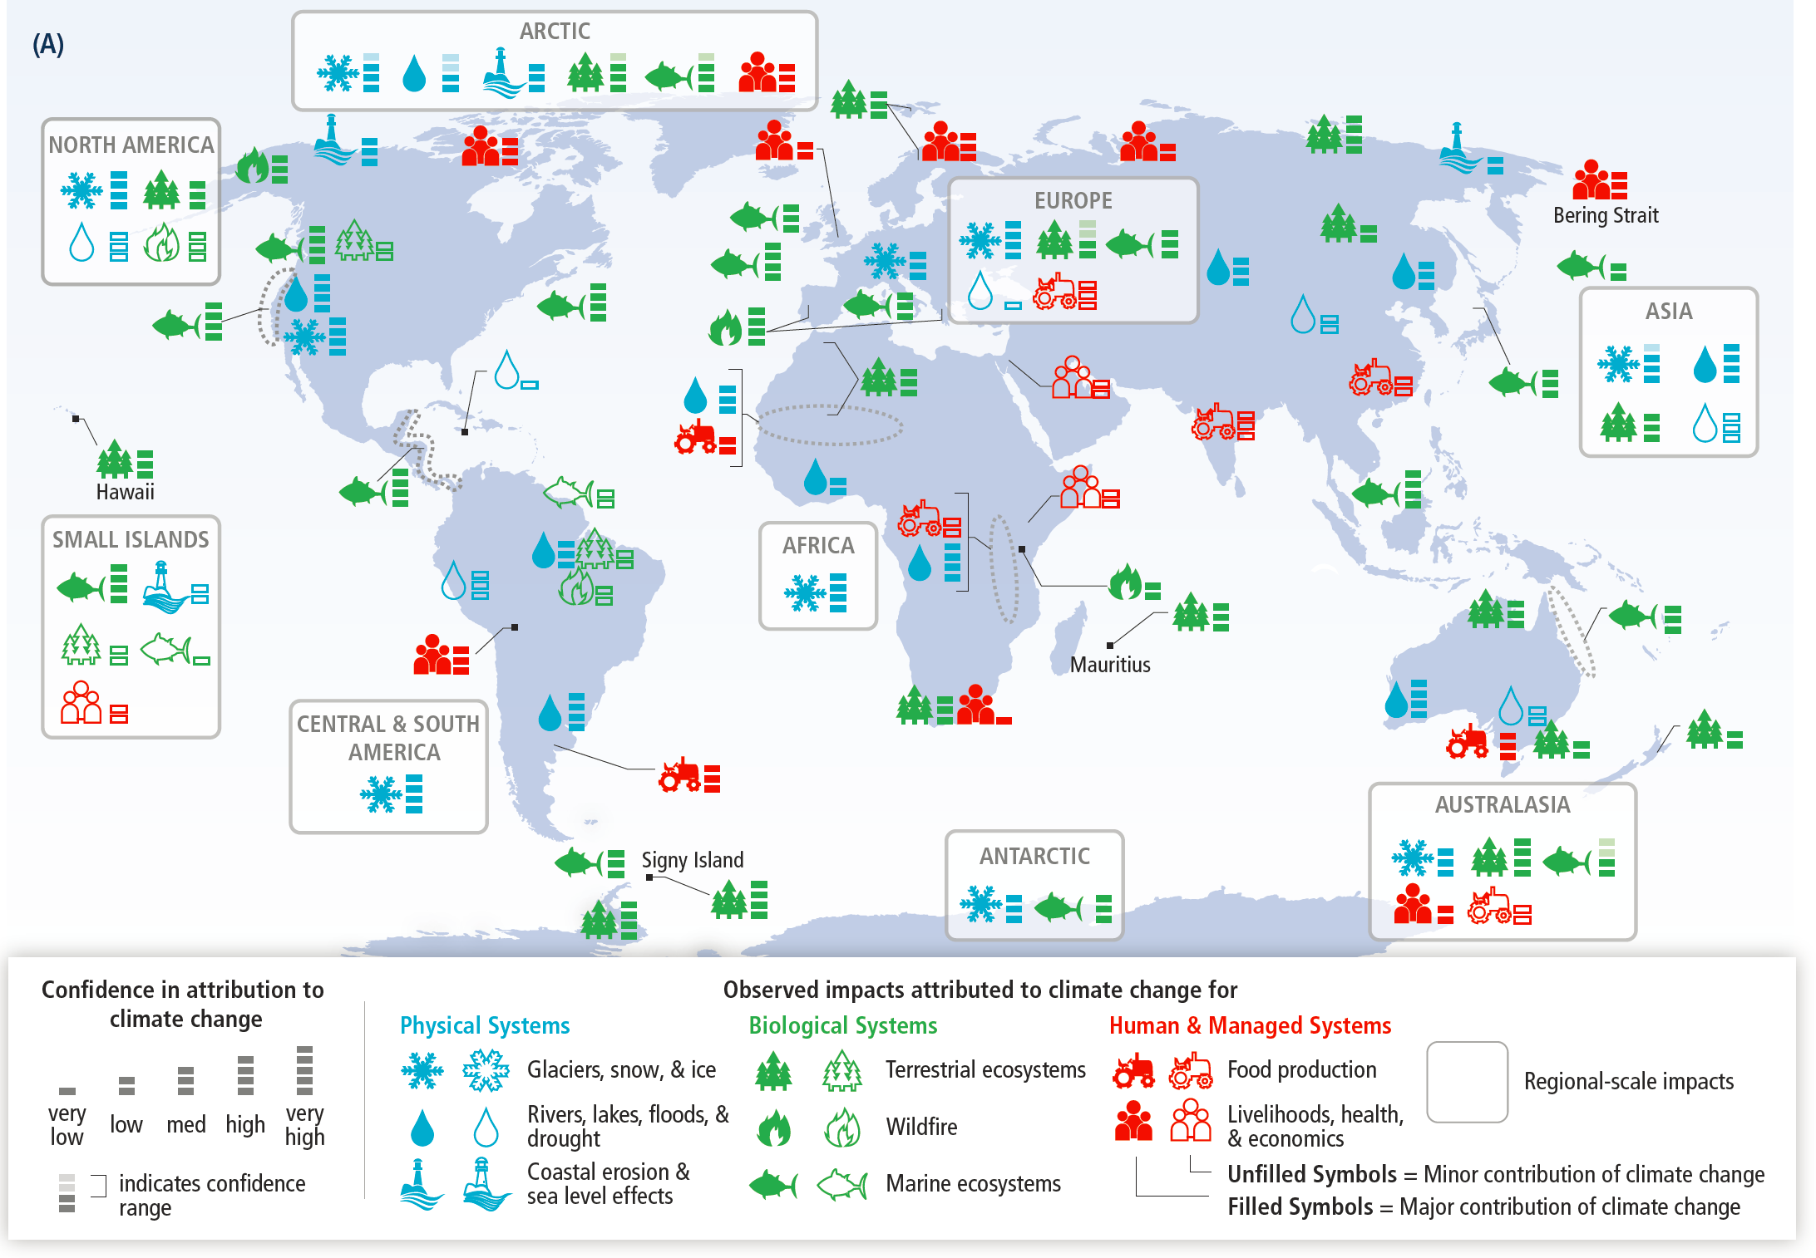

Slide 8
400
100
(359)
20
DISTRIBUTION CHANGE
(Km per Decade)
Standard Error
0
Mean
-20
Standard Error
Benthic Algae
Benthic Cnidarians
Benthic Mollusks
Benthic Crustacean
Phytoplankton
Zooplankton
Larval Bony Fishes
Non-Bony Fishes
Bony Fishes
Benthic Invert (Other)
All Taxa

Slide 9
2
0
-2
-4
90th Percentile
YIELD IMPACT
(% Change per Decade)
75th Percentile
-6
Median
25th Percentile
Wheat
Soy
Rice
Maize
10th Percentile
CROP TYPE

Slide 10
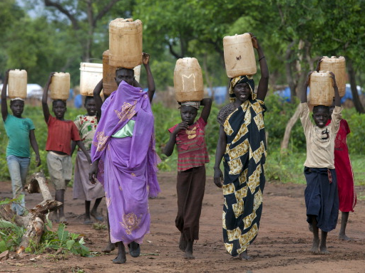
VULNERABILITY
AND EXPOSURE
AROUND THE WORLD

Slide 11
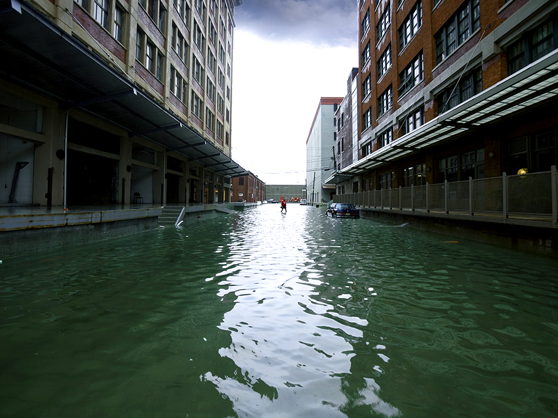
VULNERABILITY
AND EXPOSURE
AROUND THE WORLD

Slide 12
ADAPTATION IS
ALREADY OCCURING

Slide 13
ADAPTATION IS
ALREADY OCCURING

Slide 14
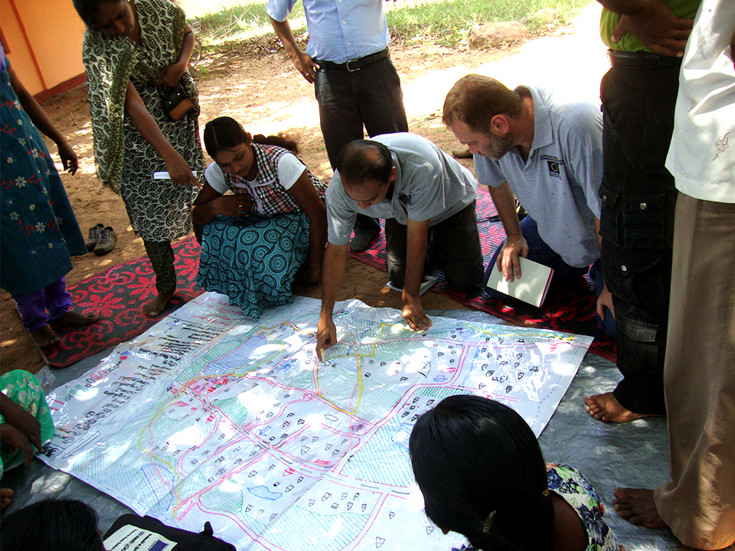
CLIMATE CHANGE
REDUCING AND
MANAGING RISKS

Slide 15
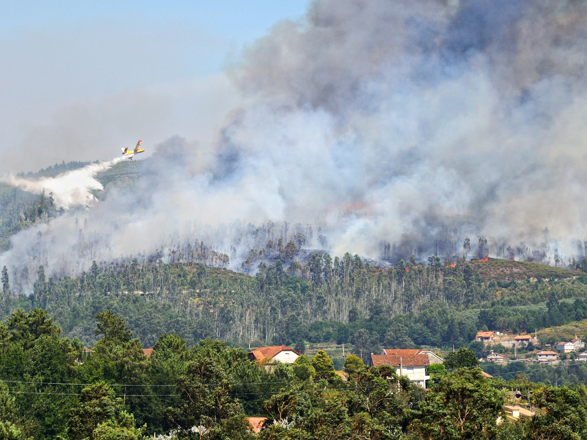
INCREASING MAGNITUDES
OF WARMING INCREASE
THE LIKELIHOOD OF
SEVERE AND
PERVASIVE IMPACTS

Slide 16
SCOPING
Identify Risks,
Vulnerabilities,
and Objectives
Establish Decision-
Making Criteria
IMPLEMENTATION
ANALYSIS
Review
and Learn
Implement
Decisions
Identify
Options
Assess
Risks
Monitor
Evaluate
Tradeoffs

Slide 17
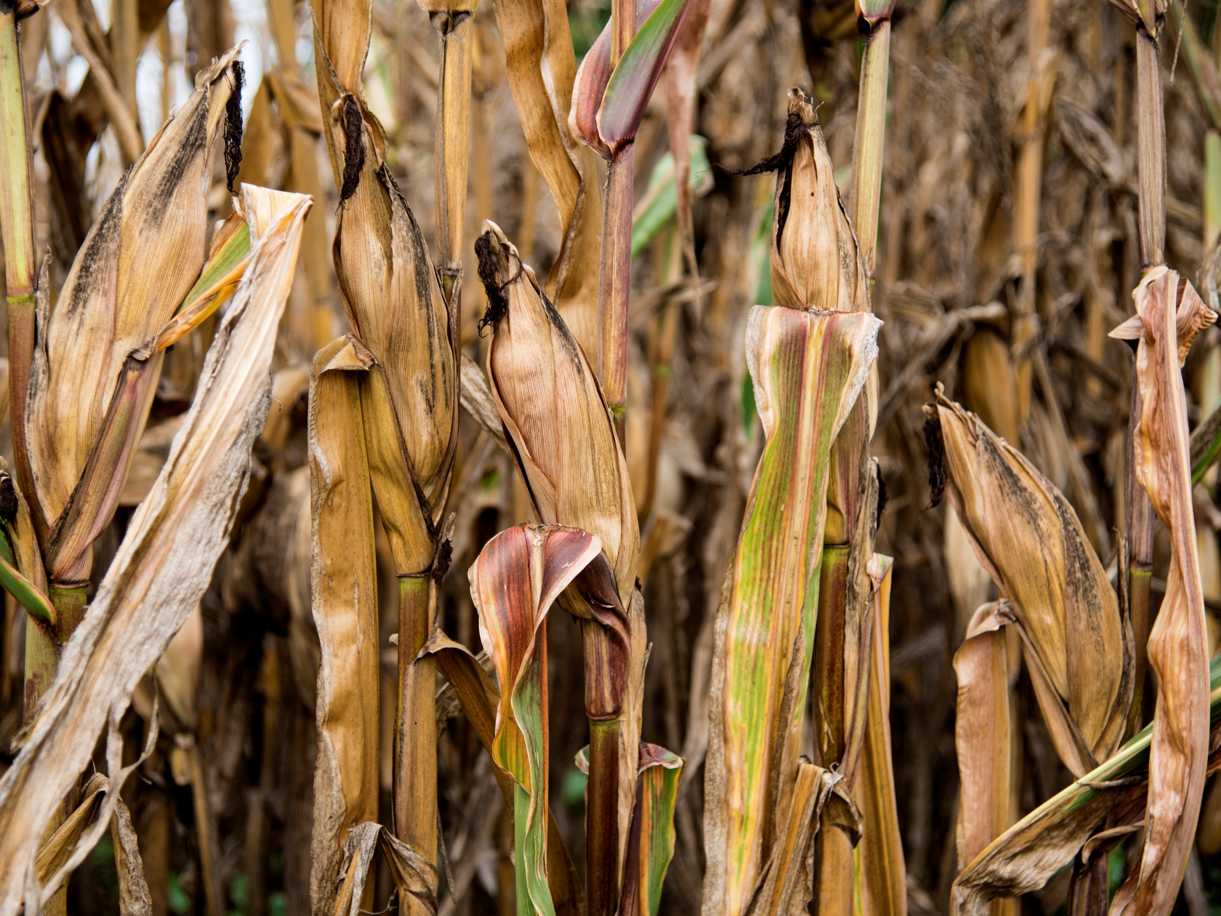
RISKS OF
CLIMATE CHANGE
INCREASE
WITH CONTINUED
HIGH EMISSIONS

Slide 18
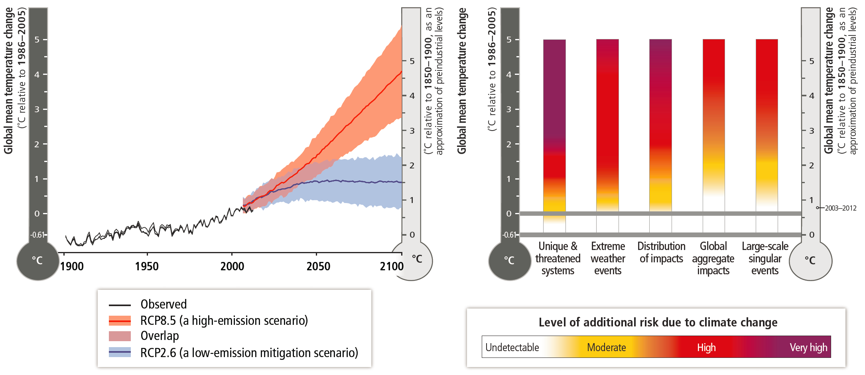

Slide 19
MAXIMUM SPEED AT WHICH SPECIES CAN MOVE
(km per decade)
0
20
40
60
80
100
Trees
Herbaceous Plants
Split-hoofed
Mammals
Carnivorous
Mammals
Rodents
Primates
Plant-feeding
Insects
Upper Bound
Median
Freshwater
Mollusks
Lower Bound
RCP2.6
Flat Areas
and Global
Average
RCP4.5
Flat Areas
RCP6.0
Flat Areas
RCP8.5
Flat Areas
AVERAGE CLIMATE VELOCITY 2050-2090
RCP8.5
Global Average

Slide 20
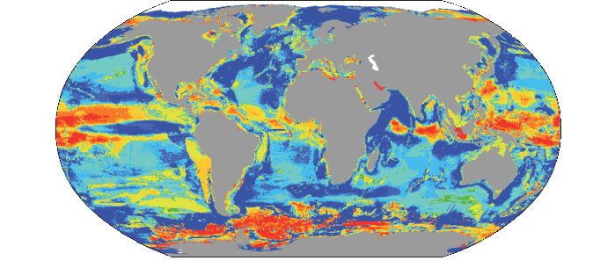
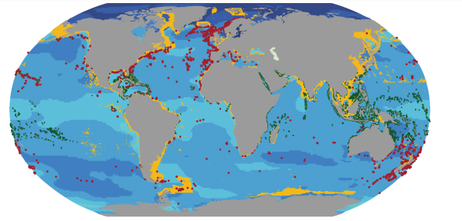
CHANGE IN MAXIMUM CATCH POTENTIAL (2051-2060 COMPARED TO 2001-2010, SRES A1B)
<50%
-21 – 50%
-6 – 20%
-1 – 5%
No data
0 – 4%
5 – 19%
20 – 49%
50 – 100%
>100%
CHANGE IN pH (2081-2100 COMPARED TO 1986-2005, RCP 8.5)
-0.60
-0.55
-0.50
-0.45
-0.40
-0.35
-0.30
-0.25
-0.20
-0.15
-0.10
-0.05
Mollusk and
Crustacean Fisheries
Present-day annual catch
rate ≥0.005 tonnes km²
Cold-Water Corals
Warm-Water Corals
MOLLUSK
CRUSTACEANS
COLD-WATER CORALS
WARM-WATER CORALS
100
40
16
15
31
29
100
37
4
9
18
23
100
7
2
7
5
3
100
26
9
15
23
20
Positive Effect
80
80
80
80
No Effect
60
60
60
60
SPECIES (%)
40
40
40
40
20
20
20
20
0
0
Negative Effect
0
0
500-650
500-650
500-650
500-650
Control
651-850
Control
651-850
Control
651-850
Control
651-850
851-1370
851-1370
851-1370
851-1370
1371-2900
1371-2900
1371-2900
1371-2900

Slide 21
CHANGE IN MAXIMUM CATCH POTENTIAL (2051-2060 COMPARED TO 2001-2010, SRES A1B)
<50%
-21 – 50%
-6 – 20%
-1 – 5%
No data
0 – 4%
5 – 19%
20 – 49%
50 – 100%
>100%

Slide 22
100
Range of Yield Change
50 – 100%
80
25 – 50%
Increase
in Yield
10 – 25%
60
5 – 10%
0 – 5%
40
0 – -5%
PERCENTAGE OF
YIELD PROJECTIONS
-5 – -10%
Decrease
in Yield
-10 – -25%
20
-25 – -50%
-50 – -100%
0
2010-2029
2030-2049
2050-2069
2070-2089
2090-2109

Slide 23
Very
Low
Risk-Level
Very
High
Med
Present
Near Term (2030-2040
POLAR REGIONS
Long Term
(2080-2100
2°C
Risks for
Ecosystems
Risks for Health
and Well-Being
Unprecedented Challenges,
Especially from Rate of Change
4°C
Risk Level with
High Adaptation
Potential for
Additional Adaptation to Reduce Risk
Risk Level with
Current Adaptation
NORTH AMERICA
EUROPE
Increased Flood Losses and Impacts
Increased Losses and
Impacts from Extreme
Heat Events
Increased Risks
from Wildfires
Heat-Related
Human Mortality
Damages from River
and Coastal Urban Floods
ASIA
Increased Water Restrictions
Increased Flood
Damage to
Infrastructure , Livelihoods,
and Settlements
Heat-Related
Human Mortality
Increased Drought-
Related Water and
Food Shortage
THE OCEAN
Reduced Fisheries
Catch Potential
at Low Latitudes
AFRICA
Compounded Stress
on Water Resources
CENTRAL AND SOUTH AMERICA
r
Reduced Water
Availability and
Increased Flooding and Landslides
SMALL ISLANDS
Significant Change in
Composition and Structure
of Coral Reef Systems
AUSTRALASIA
Increased Mass Coral
Bleaching and Mortality
Reduced Crop Productivity
and Livelihood and Food Security
Loss of Livelihoods,
Settlements,
Infrastructure, Ecosystem Services, and Economic Stability
Reduced Food
Production and Quality
Increased Risks
to Coastal
Infrastructure
and Low-Lying
Ecosystems
Coastal Inundation
and Habitat Loss
Vector- and Water-
Borne Diseases
Increased Flood Damage
to Infrastructure and
Settlements
Vector-Borne Diseases
Risks for Low-Lying
Coastal Areas

Slide 24
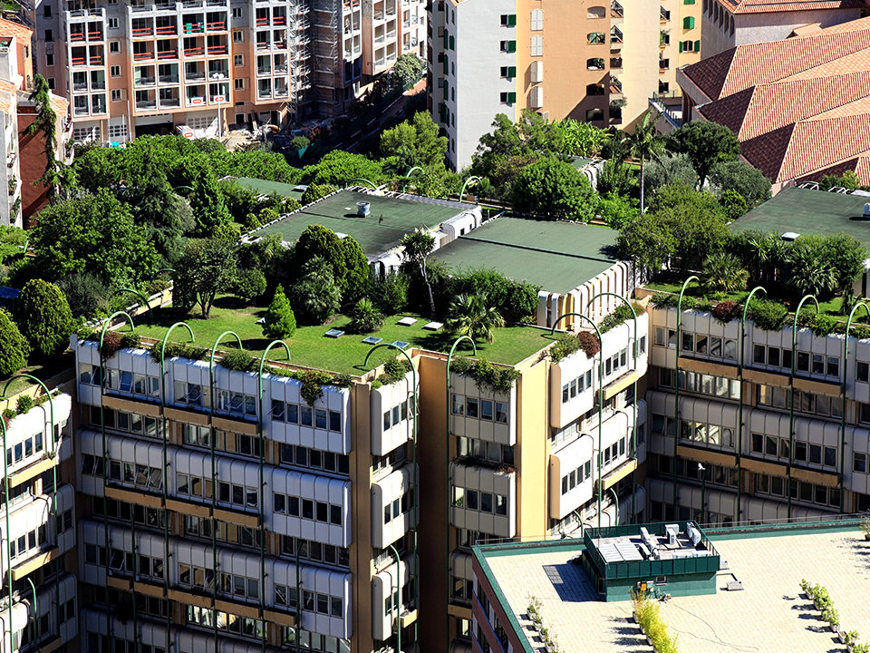
EFFECTIVE CLIMATE
CHANGE ADAPTATION
A MORE VIBRANT WORLD

